Slide 1



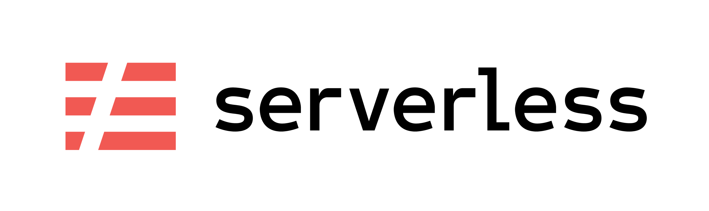
Aufbau

Slide 2
Zerlegung in atomare Einheiten
- Usermgmt
- User create
- Sales
- Store
- Usermgmt
- User retrieve
- Sales
- Store
- User update
Notes:
functional example
monolith
most of you know this from designing microservice
different teams
different compute/memory
network complexity is rising
pet – cattle - butterflies

Slide 3
Aufbau
- aufrufen ansonsten ändert sich Wert nicht

Slide 4
Aufbau
N notebook – mit N accounts
serverless
elastic

Slide 5
Aufbau
aufteilung/architektur von frontend und backend

Slide 6
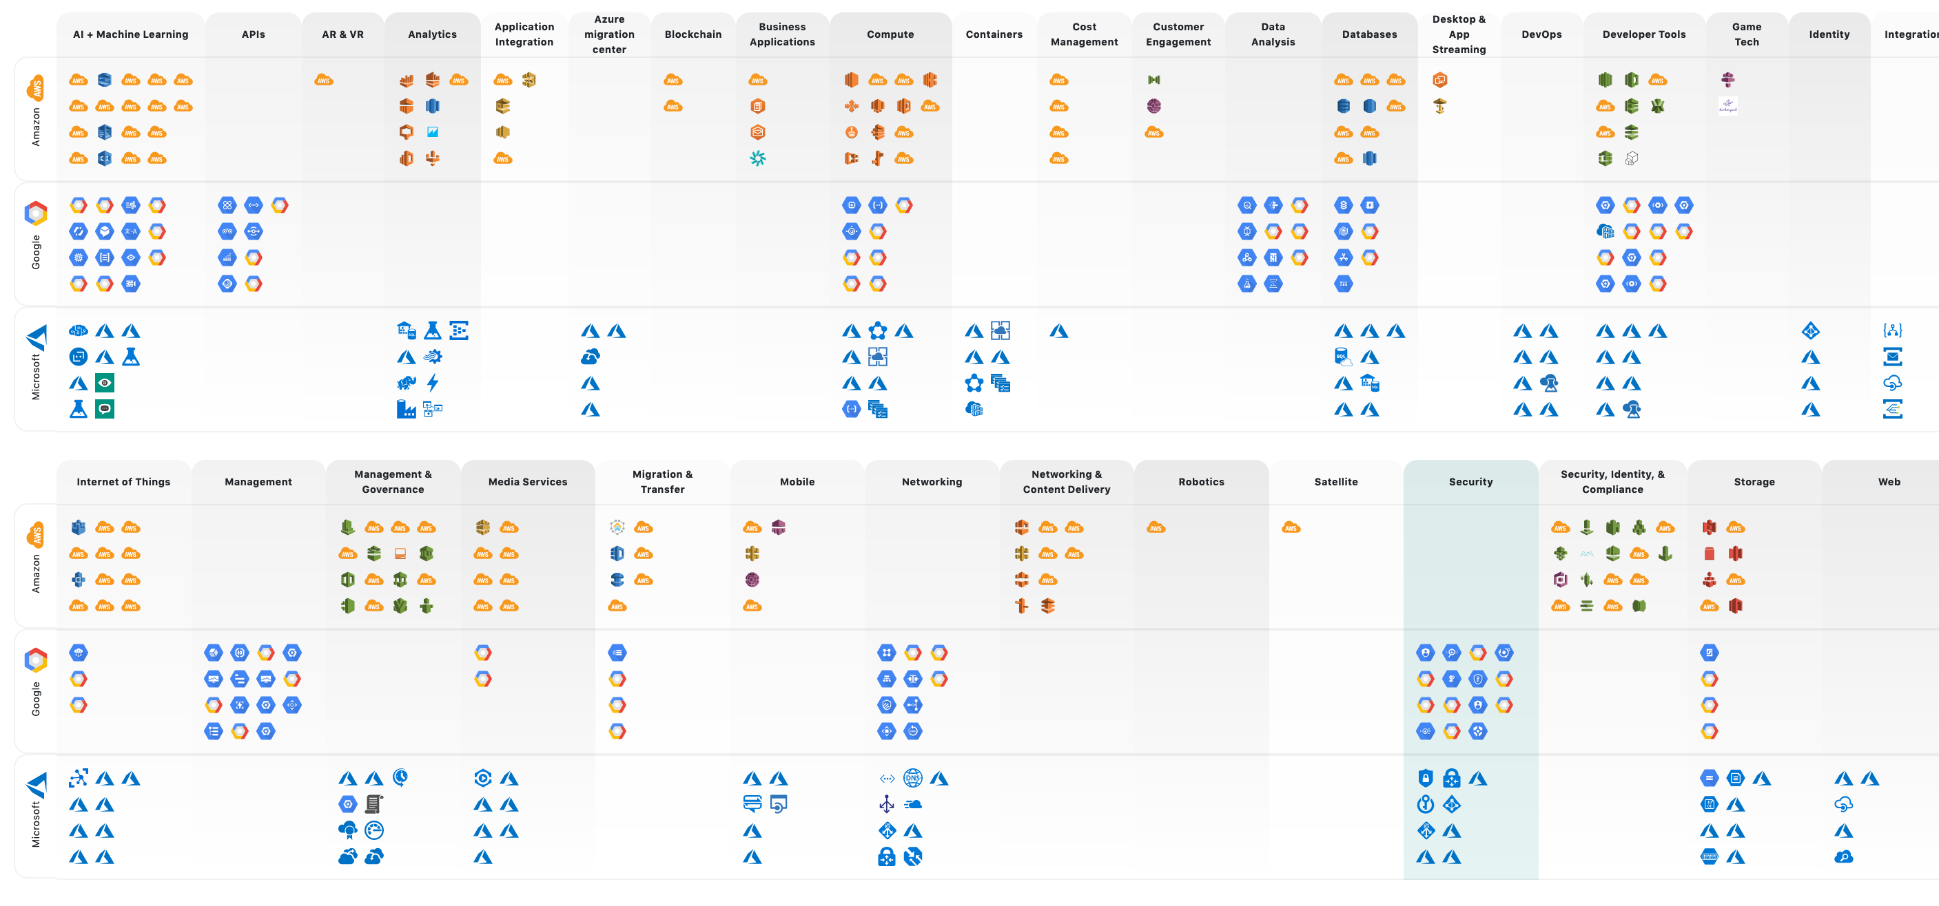
Über 400 Dienste stehen zur Auswahl
http://cloudlandscape.fe-in-der-cloud.de

Slide 7
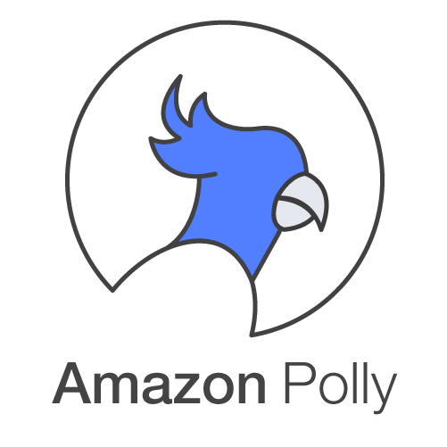
Wir wählen für heute Polly

Slide 8
Noch mehr Dienste benötigt?
…
AWS Rekognition
AWS Translation

Slide 9
Der Weg zu Cloud Native
Observability – Komplexität beobachten
Platform – Automation & Integration
DevOps – Build, run & fix
Resillienz – Ausfallsicherheit
Serverless – Reaktionszeit
Notes:
! Robuste Cloud Native App
Logging und Metriken sammelt die Cloud
Automatisierung + Integration
build, run & fix
Ausfallsicherheit über Skalierung und Cloud Native Patterns#
Reaktionszeit

Slide 10
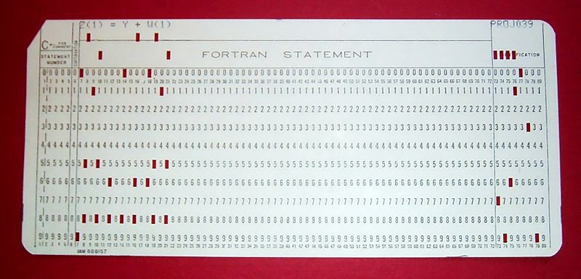
Wo alles begann
Notes:
1950 IBM Mainframe
- batch - Fortran – eingabekarte
PC Area
– Demokratisierung
Cloud Area
- Mitte 2000
SLS
- 2012 - BaaS -> authenticator Facebook/Google
Platt Service als API angeboten -> Bezahlung nach nutzen
- 2014 FaaS

Slide 11
Aufbau
API
Dienste
Funktionen
Notes:
API
standartisierte Programmierschnittstelle
REST / SOAP über HTTP
Dienste
Ganz normale Dienste
Db, Storage, Streaming, Iot, Maschine Learning …
Die meisten haben einen Trigger -> Funktionen
Funktionen
Ganz normaler code
kann mit jeder API in der cloud aufrufen

Slide 12
Zerlegung in atomare Einheiten
- Usermgmt
- User create
- Sales
- Store
- Usermgmt
- User retrieve
- Sales
- Store
- User update
Notes:
functional example
monolith
most of you know this from designing microservice
different teams
different compute/memory
network complexity is rising
pet – cattle - butterflies

Slide 13
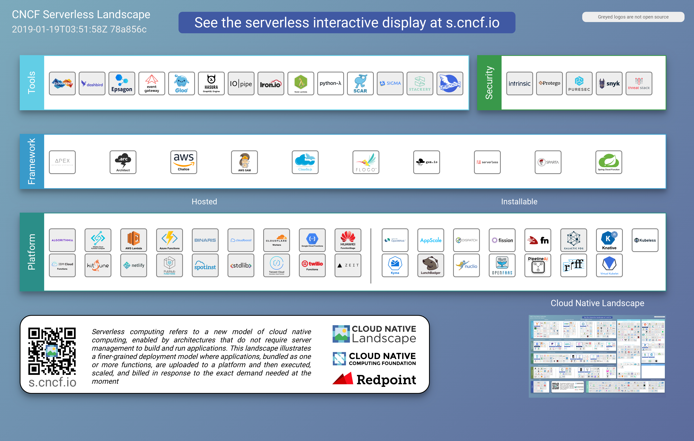
Wie passt es zu CloudNative?
Notes:
wo hat das ganze nun seinen Platz bei Cloud Native?

Slide 14
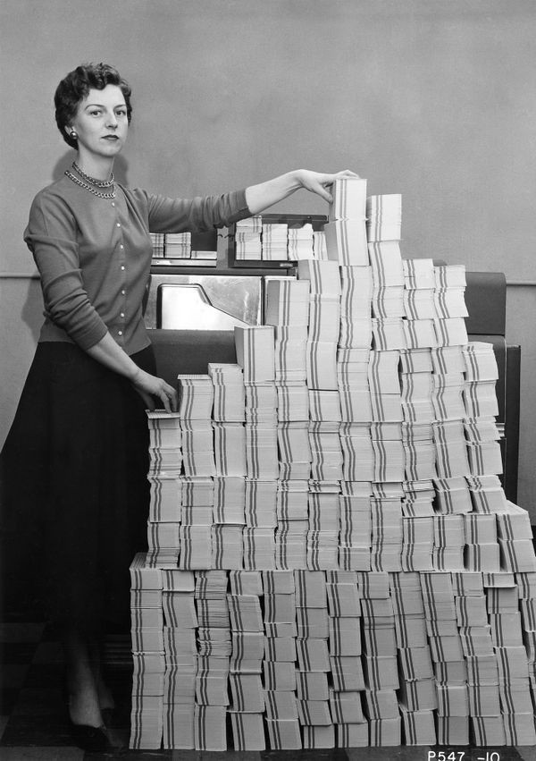
Hands-On

Slide 15
KEINE SERVER MEHR
Notes:
Agenda (2h + biopause + danach Abschluss um die Eindrücke nochmal zu reflektieren)
Ich fall gleich mal mit der Tür ins Haus. In diesem Satz stimmt etwas nicht
Warum ausgerechnet Serverless?
Hype
Invest von Cloud
-
! Robuste CloudNative App

Slide 16
Manifest
FUNKTIONEN
PERSISTENZ
SKALIERUNG
LEERLAUF
BYOC
LOGGING & METRIKEN
Notes:
Function
unit to deploy and scale - concentrate on the business code (no boilerplate)
getriggert über ein Event (z.b. eine Anfrage über Webfrontend, eine Datenbankänderung oder IoT)
hat ein definiertes Anfang und Ende
stateless + persistence elsewhere
Scales per request
Never pay for idle
BYOC
- Kelsey Hightower from Google - Fortran
Metrics and logging is an universal right

Slide 17
VELOCITY
(look in your master plan)
Notes:
lets have a look from the business side of SLS first
usual suspect:
reduce cost
When you ask how:
reducing things – which things: less servers, less dev, no ops, …
ok this is not the real goal of sls, you will have less costs, but because of an other payment model
Better argument is
speed on the road
T2M
leave buzzword
measure from idea to production, feedback from real customer
how: we code this idea into code – but there is a lot of other stuff preventing us from it (boilercode, infrastructure,…)
Development velocity
look into your project master plan
Back to a definition is SLS: sls is an sw architecture design, which provides a fully abstracted services for your business code and let you access all needed standard services as a API
The only thing what you write is this idea, the complete rest is handled by a vendor. If you need a persistence this is also only a line of code without more setup (ok maybe a little configuration before)
Technical side
give away responsibility and control
HW, OS, maintainance,… partly security
less Ops tasks
less boilderplate
how cool is that, a dream come true

Slide 18
DOES IT SCALE?
Notes:
Remind yourself of a situation everybody had a least once in your carrer. You are sitting in a room
and the first time in your live you can say with absolutely certainty – YES IT DOES

Slide 19
(you Wookie)
YES IT DOES!
Notes:
and the first time in your live you can say with absolutely certainty – YES IT DOES
…and yes sorry I lied about my color usage
The reason is simple
its unlimited by cloud providers
its managed, scale by design (by default dont configure it)
its fault tolerance ( high available )

Slide 20
time
LIMITS
memory
500 ms
512 MB
1 million invocations
----------------
4,3 $
250 ms
2048 MB
1 million invocations
----------------
8,5 $
For the sake of an example
1.
invocations
2.
coldstart
Notes:
Assume functions as a prison of time, memoryspace and lines of code per invocation
– wake up time the same, dinner, lunch and even the toilette time is stricly limited – 5minutes
cell has 5sqm – thats better than the average roomsize in munich – 3 GB
how much prisoners/code you get into one cell - (50mb)
Coldstart
its like a managed container, with a limited access to OS
Weakness
costs are hard to predict and can explode! Play around with it
Vendor lock-in – BUT think about what it costs you setup, before you can write one line of code
https://s3.amazonaws.com/lambda-tools/pricing-calculator.html
request costs
execution costs GB/s
There are more Weakness, but not this time

Slide 21
time
PA¥ P€R R€QU€$T
cost
3.
1.
pay per usage e.g. VM
2.
pay per request
Notes:
container at least one is running
For every request the costs are rising
Half the truth
Dont forget BaaS - this comes on top

Slide 22
(more WTF moments)
WHAT AWAITS US?
Notes:
high learning curve (slow down, to go fast)
- a lot of services
variety
- big 4
opensource
Kubernetes (Knative)
CNCF

Slide 23
NO MORE OPS
Notes:
Schon wieder Ironie
- security
- you will have more to control
- system architecture
- observerbality
=> more efficience
=> you will grow
=> from pet to cattle to butterflie trainer

Slide 24
DOES IT FIT FOR ME?
(It depends... is not the answear)
Notes:
Last question for today
The answear is not it depends – its try it out!
Why? Generic concept – a around your programming language (not an domain specific language)
startup
gluecode for cloud services
archive, cleanup,…
single page apps – REST + Angular
rapid prototype
Event Based – Pipelines
Future: ML, edge computing

Slide 25
#2019
Notes:
Why? There are three good reasons
First is you are already familiar with concept of Cloud, Kubernetes and other Scalable or managed services (mindset changed towards more smaller code, which is more unpredictable in large scale)
very big commitment in sls (also in money) – we came here to stay – e.g. managed db there can be a trigger
because the guru of SLS Simon Wardley itself said so – so please believe

Slide 26
Hands-On

Slide 27
time * invocations
ITS ABOUT €
cost
Notes:
The answear is not it depends – its try it out!

Slide 29









Slide 30
? INSTALL CONFIGURE

Slide 31







